Slide 1
OVARIAN CANCER DIAGNOSIS AND MORTALITY PREDICTION USING DEEP LEARNING
MAJOR PROFESSOR : DR. XIUWEN LIU
PRESENTED BY : APURVA KATTI

Slide 2
CONTENTS
Introduction
Existing Work
Problem Statement
Datasets
Method – Neural Network
Experimental Results
Conclusion And Future Work

Slide 3
1. INTRODUCTION

Slide 4
Ovarian Cancer is the 5 ^{th} leading causes of cancer death in women
Ovarian cancer symptoms either aren’t apparent in the early stages or they mimic stomach and digestive issues

Slide 5
2. EXISTING WORK

Slide 6
High risk prediction using a 3-tier stratification scheme-logistic regression [1]
Application of Artificial Intelligence for Preoperative Diagnostic and Prognostic Prediction in Epithelial Ovarian Cancer Based on Blood Biomarkers [2]
How screening influenced outcomes and survival from type II malignancies differently from slower growing tumors [3]

Slide 7
3. PROBLEM STATEMENT

Slide 8
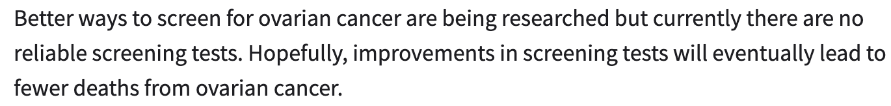
CT/PET Scan
CA125 Test
Transvaginal Ultrasound
Laparoscopy

Slide 9
4. DATASET

Slide 10
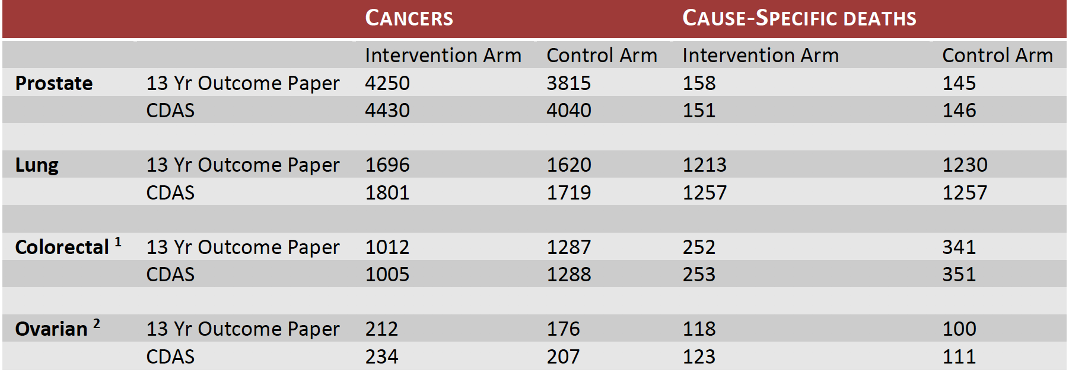
National Cancer Institute (NCI) conducted 13 year trial studying PLCO (Prostate, Lung, Colorectal, Ovarian)
Intervention and Control Arm
CA-125 Test and Transvaginal Test

Slide 11
Primary Dataset *
Secondary Dataset
Detailed Screen results *
Abnormality
Diagnosis
Medical Complications
Treatments

Slide 12
Mortality Prediction and Cancer Diagnosis
78216
256
262
30482
248
HIGHLY IMBALANCED
SMALL SIZE

Slide 13
5. NEURAL NETWORKS

Slide 14
Instead of using only Fully Connected Layered network, a combination of Locally Connected and Fully Connected Layered networks were used.
Relu, Tanh, Elu, Selu – input and hidden
Softmax - output
Batch size – 32
Learning Rate - 0.00001, 0.000015
Early Stopping – patience (3)
Wikipedia-images

Slide 15
To solve small sized data and imbalance problem, re-sampling techniques were used
Re-sampling is a technique used to either remove samples from the majority class (under-sampling) and or add more examples from the minority class (over-sampling)
SMOTE (both for mortality and diagnosis)
TomekLinks (only for diagnosis)

Slide 16
Diagnosis had a 30482 : 248 ratio for class 0 and class 1
To solve this class Imbalance problem, the size of class 0 was further decreased by considering only 5% of the data from 10 different screening test centers.
Finally about, 1524 : 248
Further subjected to under-sampling using TomekLinks

Slide 17
TomekLinks remove unwanted overlap between classes where majority class links are removed until all minimally distanced nearest neighbor pairs are of the same class.
Kaggle.com

Slide 18
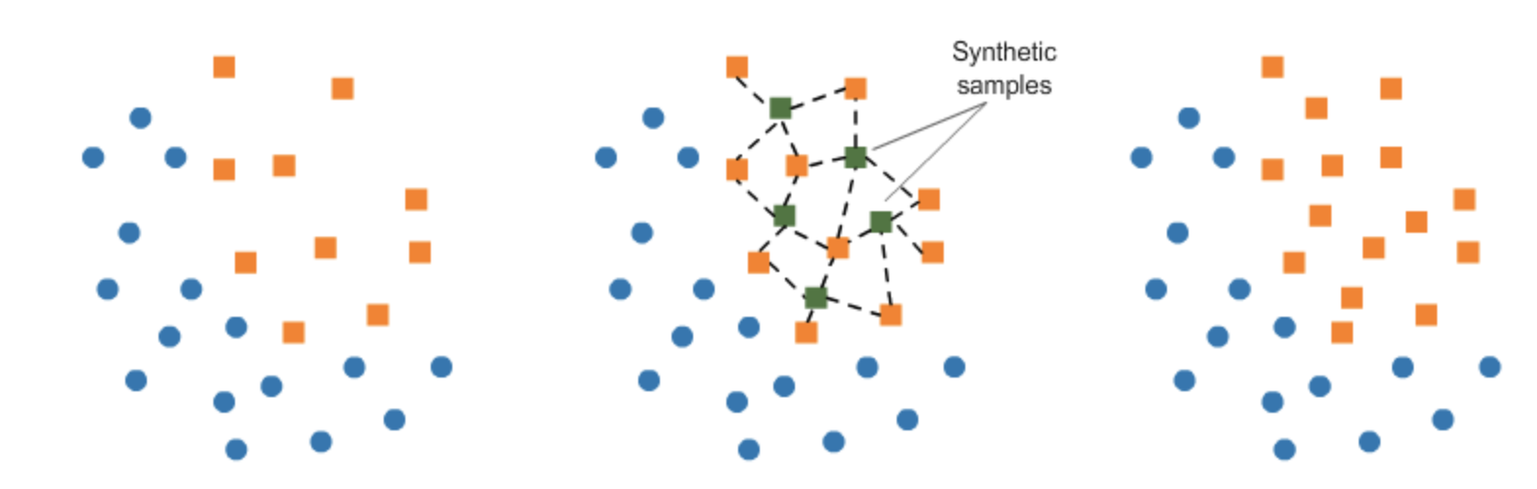
SMOTE works by randomly picking a point from the minority class and computing the k-nearest neighbors for this point. The synthetic points are added between the chosen point and its neighbors.
It was applied twice , once to up-sample class 0 and then to class 1
Kaggle.com

Slide 19
Consensus
a parameter called k out of n is chosen to specify how many models should more or less produce the similar results to predict the instance as belonging to a particular class.
There is also a parameter called the threshold probability chosen when performing consensus among k out of n models.
If the model does not satisfy the constraint on threshold, the samples are simply dropped which helps to increase the consistency
Threshold selected 0.55, 0.627 for mortality and diagnosis respectively

Slide 20
Model Interpretation
If the last layer is a softmax layer then the inputs are changed by a small value along with Jacobian matrix of a function. The Jacobian difference vector essentially determines the contributions of changes in the features, i.e., the feature
To identify consistent clusters using the correlation coefficients of the Jacobian difference vectors. Once the clusters are found, samples are added until the maximum correlation is below a threshold value
To achieve cluster quality a minimum cluster size threshold is set. Using this, the Jacobian difference for each of the models is calculated and then compared with the clusters to identify the clusters that provide highest correlation

Slide 21
6. EXPERIMENTAL RESULTS

Slide 22
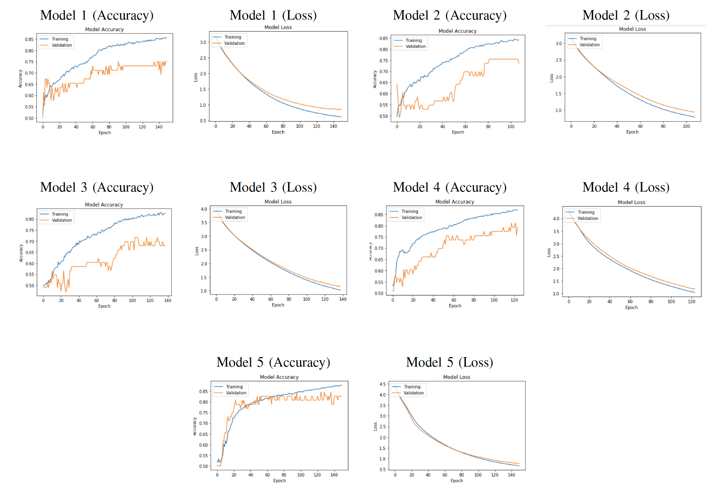
Individual Models(Mortality)

Slide 23
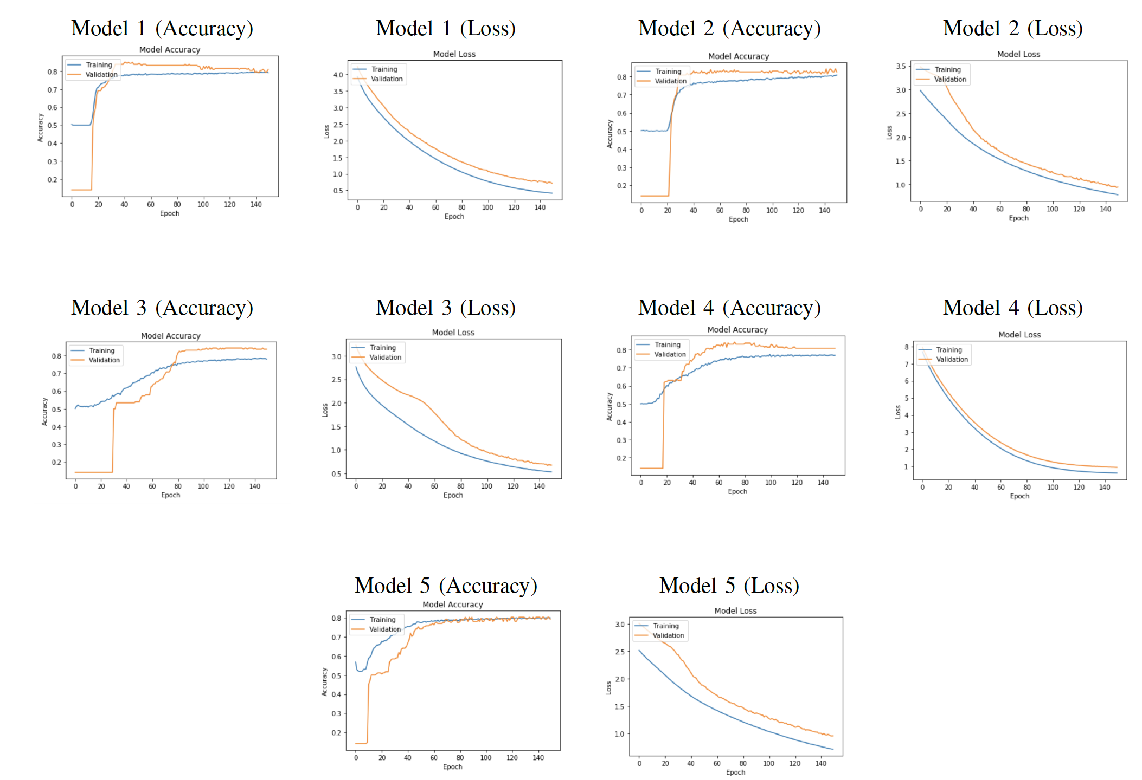
Individual Models(Diagnosis)

Slide 24
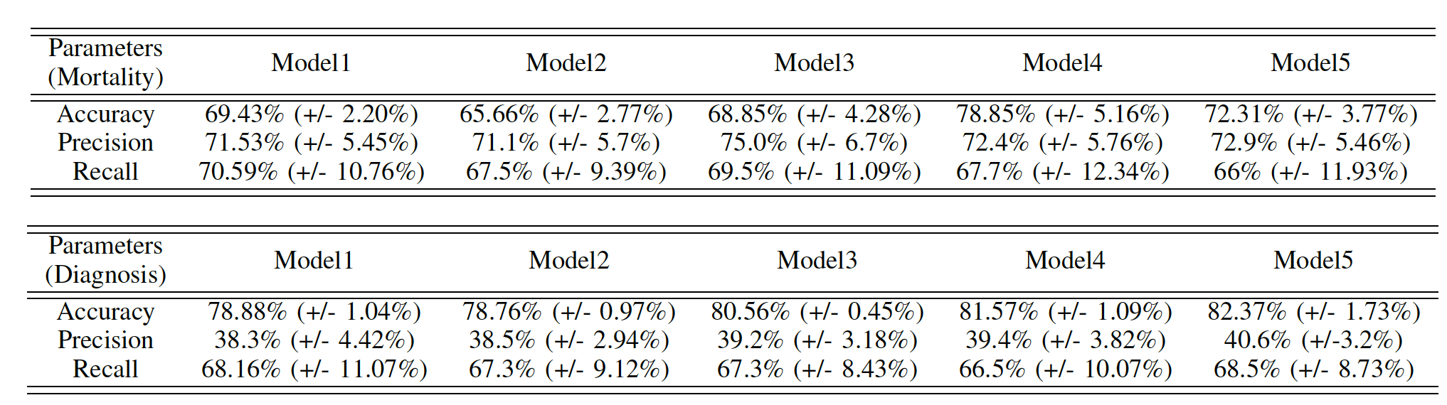
10 Fold Cross Validation

Slide 25
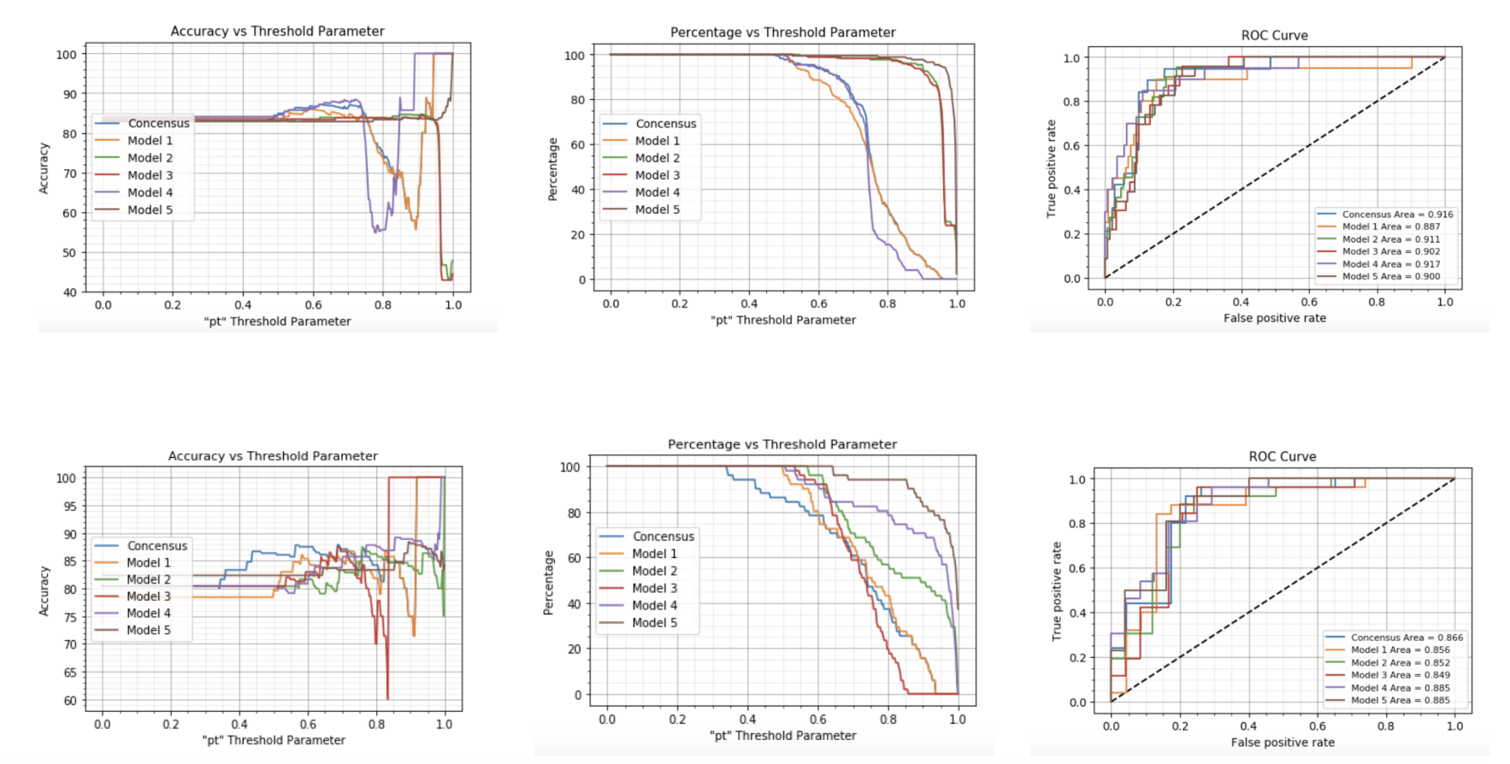
Consensus

Slide 26
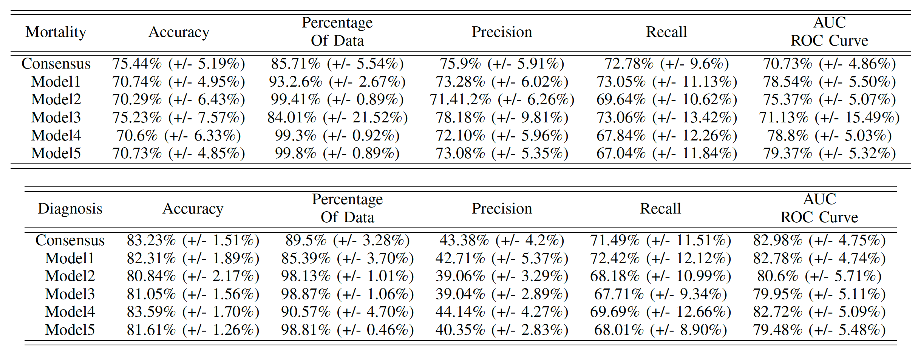

Slide 27
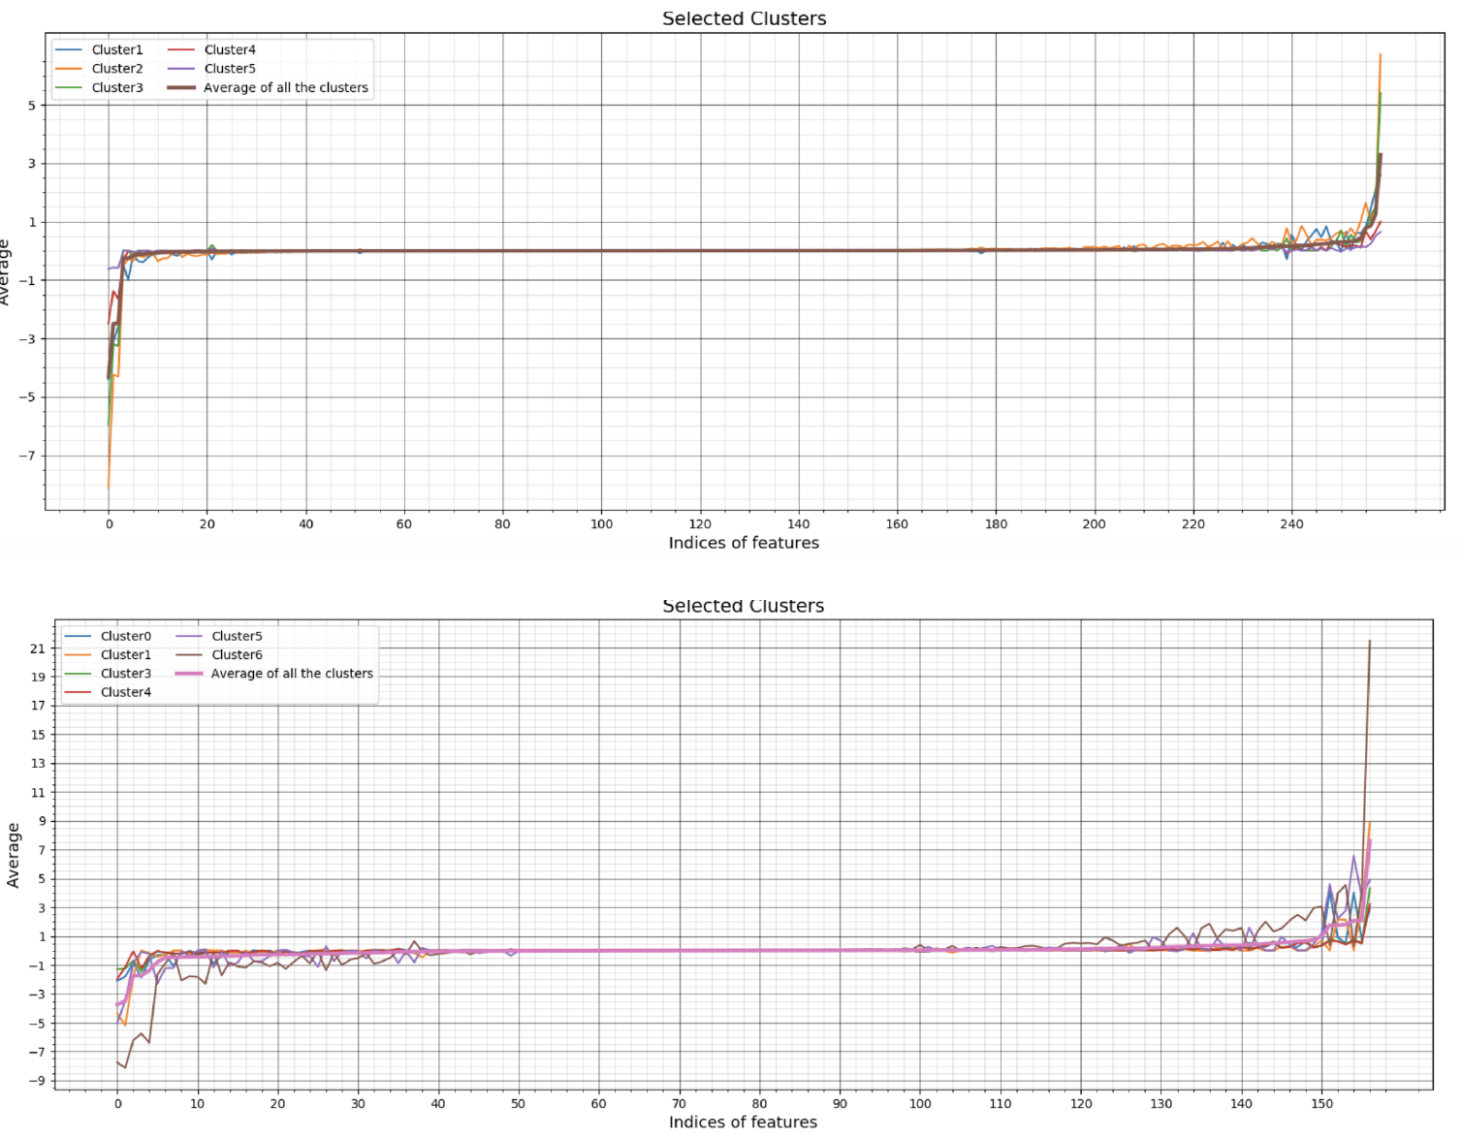
average of the Jacobian difference vector of highly correlated cluster set

Slide 28
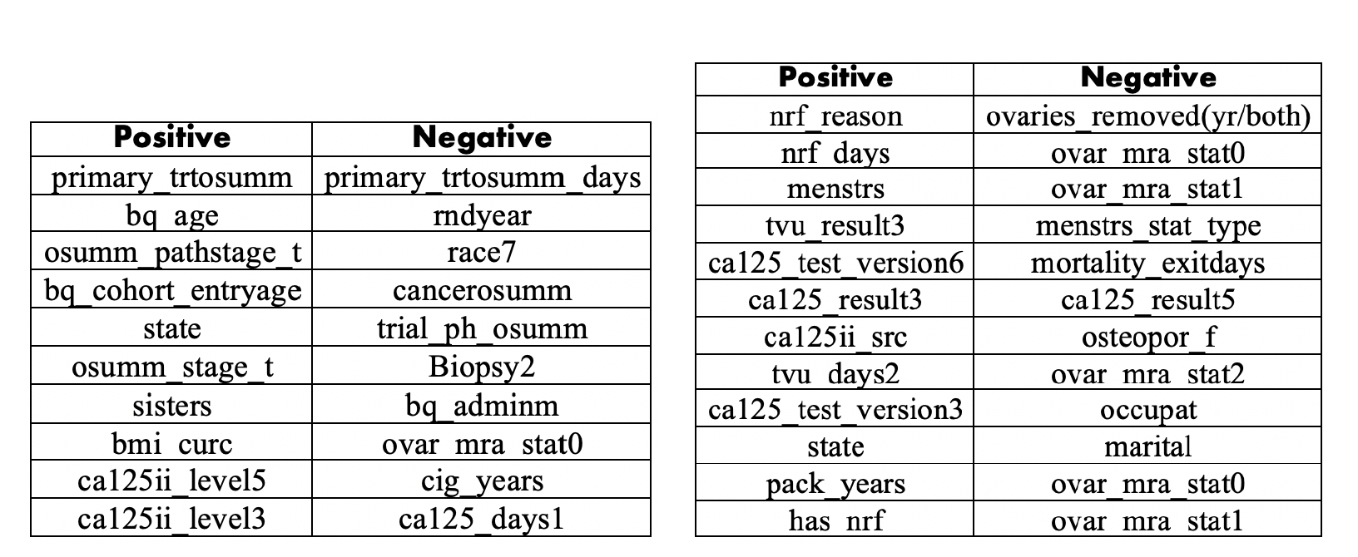
MORTALITY DIAGNOSIS

Slide 29
7. CONCLUSION AND FUTURE WORK

Slide 30
Mortality and Diagnosis Prediction (risk factor) using PLCO data
Solved Class Imbalance using TomekLinks and SMOTE
10 Fold Cross Validation
Consensus Method
Model Interpretation to understand features contribution
Extend to other PLCO dataset
Prediction of Cancer Stage

Slide 31
THANKS!

